Slide 1

Advanced Writing & Genre-Based Teaching
By Darren Van Veelen

Slide 2

TEXT
TEXT
TEXT

Slide 3
A Model of Language

Slide 4
Genre is a staged goal-oriented social process.
Jim Martin

Slide 5

“… patterns of structure and language within texts have evolved to achieve particular purposes …”
Susan Feez

Slide 6


Slide 7
Register
GENRE: Why was the text written?
FIELD: What is the text about?
TENOR: Who wrote the text and who will read it?
MODE: How is the text written?

Slide 8
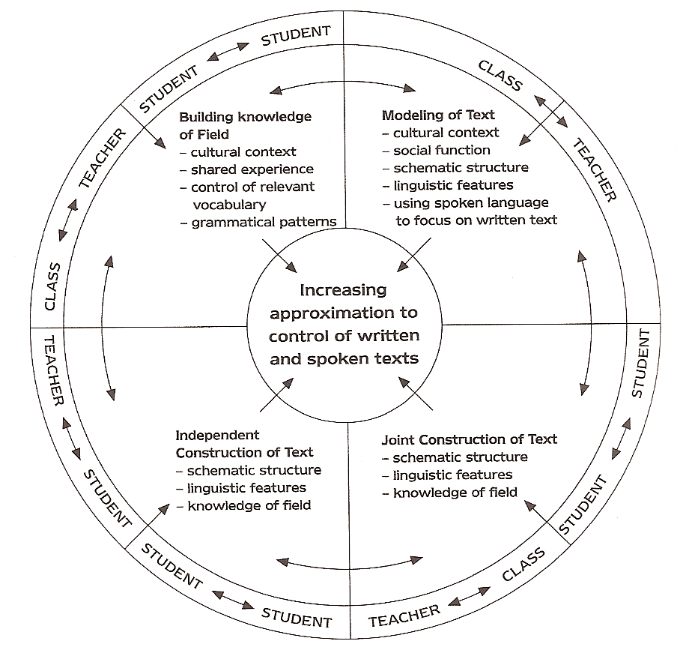
Teaching – Learning Cycle
Hammond et al.

Slide 9

Do I want to fit in?

Slide 10



E-mails
Scientific Definitions
Product Specifications

Slide 11
Part 1
E-mails

Slide 12
Register
GENRE: To communicate a need.
FIELD: Introduction, reason for absence, request for information
TENOR: Students and the teacher
MODE: Distant, respectful

Slide 13
Pre-tasks
Model
You
Together

Slide 14
Opening
Link or reason
Expression of information
Closing

Slide 15
Part 2
Scientific Definitions

Slide 16
Register
GENRE: To state a definition clearly.
FIELD: General & scientific terms
TENOR: Expert, novice, researcher
MODE: Distant, authoritative, educational

Slide 17
Pre-tasks
Model
You
Together

Slide 18
Genre
vs
Text type

Slide 19
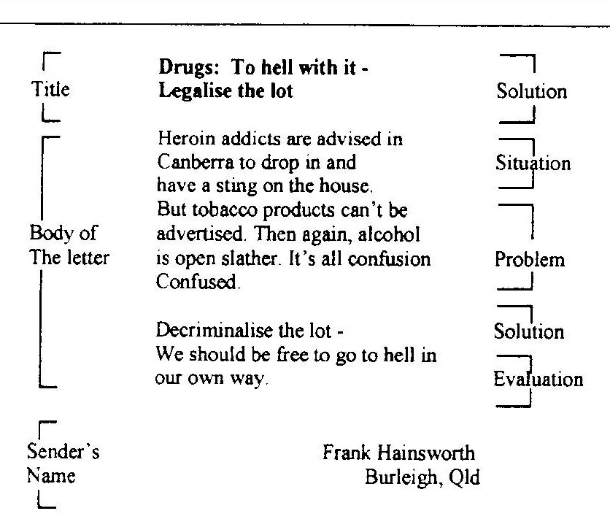
Paltridge

Slide 20
Term ^ Class ^ Characteristics

Slide 21
Part 3
Product Specifications

Slide 22
Register
GENRE: To help people choose / use a product.
FIELD: A datasheet or spec sheet summarizing performance & other technical characteristics.
TENOR: Manufacturers, consumers, retailers, designers
MODE: Objective, simply the facts

Slide 23
Pre-tasks
Model
You
Together

Slide 24
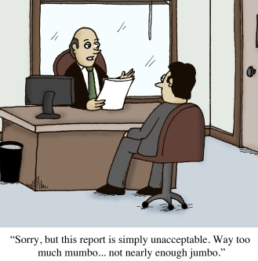
?
?

Slide 25

XENOX Bench drill machine TBX

Slide 26
E-mails
Scientific Definitions
Product Specifications

Slide 27
References
Feez, S. (1998). Text-based Syllabus Design, Sydney: National Center for English Language Teaching and Research. (NCELTR)
Hammond, J., Burns, A., Joyce, H., Brosnan, D., & Gerot, L. (1992). English for Social Purposes: A Handbook for Teachers of Adult Literacy, Sydney: National Center for English Language Teaching and Research. (NCELTR)
Martin, J. R. (2009). Genre and language learning: A social semiotic perspective. Linguistics and Education, 20 (1), 10-21.
Paltridge, B. (2002). Genre, Text Type, and the English for Academic Purposes (EAP) Classroom. In A. M. Johns (Ed.), Genre in the Classroom: Multiple Perspectives (pp. 73-90). New Jersey: Lawrence Earlbaum.

Slide 28
http://darrenvanveelenswebsite.yolasite.com/

Slide 29
Q & A

